Slide 1
moledcule
your future friendly community based programmable led controller

Slide 2

moledcule
your future friendly community based programmable led controller

Slide 3

moledcule
welcome
We
introduction
In
background
Ba
sparky jr.
Sp
kaimana
Ka
opportunity
Op
moledcule
Mo
demo
De
compiler
Co
moledcule
your future friendly community based programmable led controller
thanks
Ta

Slide 4
moledcule
welcome
We
introduction
In
background
Ba
sparky jr.
Sp
kaimana
Ka
opportunity
Op
moledcule
Mo
demo
De
compiler
Co
moledcule
your future friendly community based programmable led controller
thanks
Ta

Slide 5
moledcule
welcome
We
introduction
In
background
Ba
sparky jr.
Sp
kaimana
Ka
opportunity
Op
moledcule
Mo
demo
De
compiler
Co
moledcule
your future friendly community based programmable led controller
thanks
Ta

Slide 6
moledcule
moledcule
welcome
We
introduction
In
welcome
your future friendly community based programmable led controller specifically design for the fighting game community, modders and fightstick enthusiasts. control your LEDs (button, balltop, plate) right from molecule itself.
background
Ba
sparky jr.
Sp
kaimana
Ka
opportunity
Op
moledcule
Mo
demo
De
compiler
Co
moledcule
your future friendly community based programmable led controller
thanks
Ta

Slide 7
moledcule
welcome
We
introduction
hi, my name is eugene andruszczenko*,
and I am here to talk about moledcule
moledcule was built to:
enable non technical users to programmable RGB LEDs.
connect to your AVR microcontroller such as Arduino
compile and flash 'sketches' to the microcontroller
configure your devices
program without writing a line of code
* a.k.a 32teeth *true fact, google it
introduction
In
background
Ba
sparky jr.
Sp
kaimana
Ka
opportunity
Op
moledcule
Mo
demo
De
compiler
Co
thanks
Ta

Slide 8
moledcule
welcome
We
background
this year (2016), i turned 40! and i had realized that i had been fortunate enough to be gainfully employed, in an industry sector i love, where hobby, became job, became career... ...for 21 years. that was more than half my life, doing what i love, for money.
and then i got laid off.
as an active member of the FGC, OSH and OSS communities, and with much deserved rest and time on my hand, i started playing again, and reading the forums, and catching up on new hardware, but still i noticed that support for the third party hardware distributors was still a major headache. being one who does not sit idly by,
i decided that i can contribute to the community by giving back
introduction
In
background
Ba
sparky jr.
Sp
kaimana
Ka
opportunity
Op
moledcule
Mo
demo
De
compiler
Co
thanks
Ta

Slide 9
moledcule
welcome
We
Sparky Jr
a little over 8 year ago, Sparky Jr was unleashed on the FGC modding hubs
an AVR hardware based modular controller for RGB LED (both CA/CC)
saw 4 major releases
3 major arcade shop distribution
Introduced programmable hardware from Java app
configurator saw 4 major releases, and one Chrome App (still available)
helped and lead a standardized 20 pin breakout for all FGC based products
demonstrated at CreateInTO back in 2013!
FITC 2014!
introduction
In
background
Ba
sparky jr.
Sp
kaimana
Ka
opportunity
Op
moledcule
Mo
demo
De
compiler
Co
thanks
Ta

Slide 10
moledcule
welcome
We
kaimana
a 3rd party offshoot of Sparky Jr by Paradise Arcade Shop
released 2014
two versions (mini and khaimana)
khaimana featured advanced soft switch between config and soft usb passthrough
introduction
In
background
Ba
sparky jr.
Sp
kaimana
Ka
opportunity
Op
moledcule
Mo
demo
De
compiler
Co
thanks
Ta

Slide 11


moledcule
welcome
We
opportunity
the kaimana modules became widely popular but:
user wanted customization
required install of Arduino IDE
not everyone is a C/C++ developer
growing community support (over 1000 post on one thread on SRK alone)
NONE OF THESE PROPLEM WHERE MINE
Sparky Jr was
the intent was to build out a native solution that anyone can use
which actually became…
introduction
In
background
Ba
sparky jr.
Sp
kaimana
Ka
opportunity
Op
moledcule
Mo
demo
De
compiler
Co
thanks
Ta

Slide 12

moledcule
welcome
We
opportunity
the 7 layer mean stack
introduction
In
background
Ba
sparky jr.
Sp
kaimana
Ka
mongo
express
angular
node
avrgirl
codebender
amazon
opportunity
Op
moledcule
Mo
demo
De
compiler
Co
thanks
Ta

Slide 13

moledcule
welcome
We
opportunity
the 7 layer mean stack
introduction
In
background
Ba
sparky jr.
Sp
kaimana
Ka
mongo
express
angular
node
avrgirl
codebender
amazon
opportunity
Op
moledcule
Mo
demo
De
compiler
Co
thanks
Ta

Slide 14
moledcule
welcome
We
moledcule
your future friendly community based programmable led controller specifically design for the fighting game community, modders and fightstick enthusiasts. control your LEDs (button, balltop, plate) right from molecule itself.
introduction
In
background
Ba
sparky jr.
Sp
kaimana
Ka
opportunity
Op
moledcule
Mo
demo
De
compiler
Co
thanks
Ta

Slide 15
moledcule
welcome
We
welcome
your future friendly community based programmable led controller specifically design for the fighting game community, modders and fightstick enthusiasts. control your LEDs (button, balltop, plate) right from molecule itself.
introduction
In
background
Ba
sparky jr.
Sp
kaimana
Ka
opportunity
Op
moledcule
Mo
demo
De
compiler
Co
thanks
Ta

Slide 16
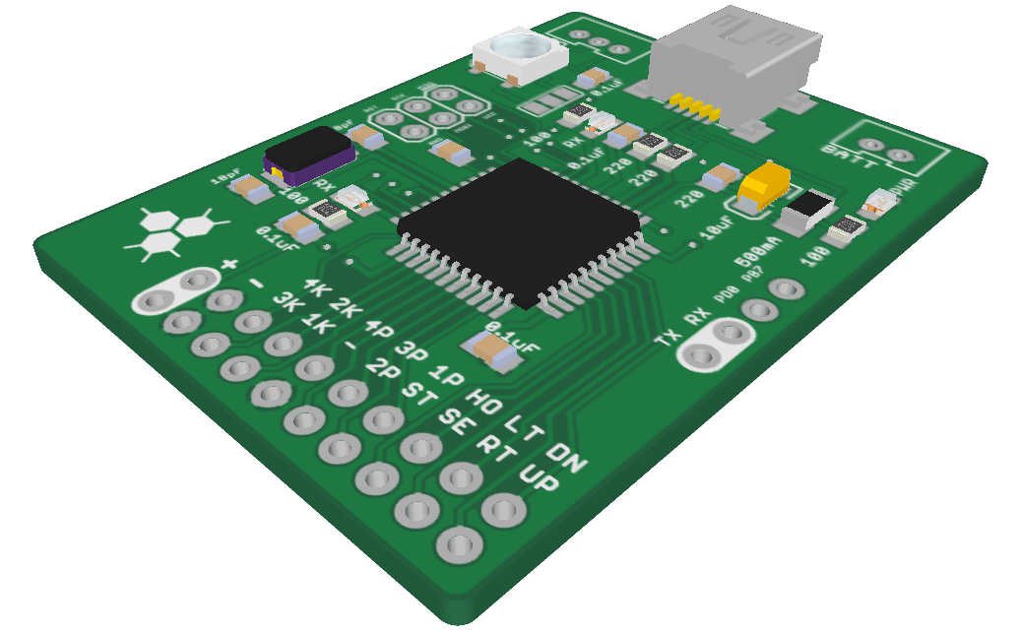
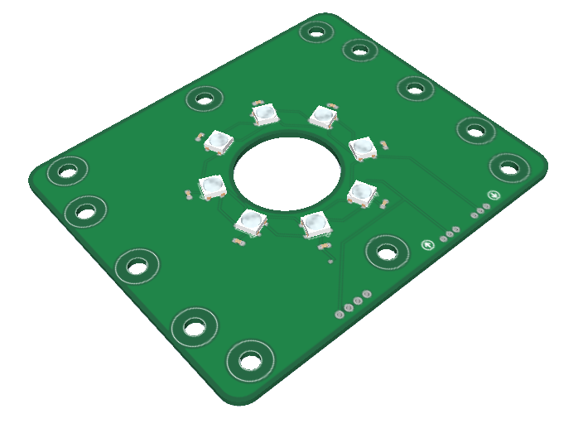
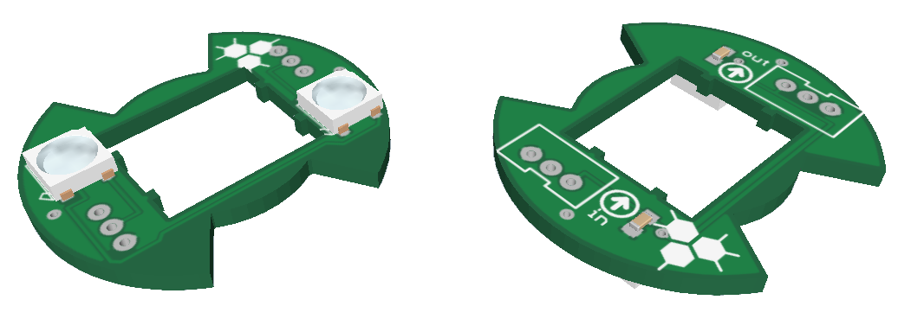
moledcule
welcome
We
welcome
your future friendly community based programmable led controller specifically design for the fighting game community, modders and fightstick enthusiasts. control your LEDs (button, balltop, plate) right from molecule itself.
introduction
In
background
Ba
sparky jr.
Sp
kaimana
Ka
opportunity
Op
moledcule
Mo
demo
De
compiler
Co
thanks
Ta

